Slide 1
Data Structures

Slide 2
Types of Data Structures
Lists
Arrays (numpy)
Tuples
Dictionaries
Set
Linked List
Queue
Stack
Data Frame
Data Base

Slide 3
Lists
List is a collection which is ordered and changeable. Allows duplicate members.
The list is the most important data type in python language. The most important advantage of the list is the elements inside the list. It does not have to be the same data type and you can use negative indexing. All the operations of the string is similarly applied on list data type such as slicing, concatenation, etc. In addition, we can create the nested list (a list containing another list).
The costly operation is inserting or deleting the element from the beginning of the list as all the elements are needed to be shifted. Insertion and deletion at the end of the list can also become costly in the case where the preallocated memory becomes full.

Slide 4
Array
Numpy arrays are very powerful for complex mathematical calculations.
It can handle heavy arithmetic operations,
It is mostly used for longer sequence of data elements.
It is used for accounting, financial prediction statistics, …

Slide 5
Sets
Set is a collection which is unordered, mutable* and unindexed. No duplicate members.
* sets are mutable but only contain immutable items
You cannot change its items, but you can add \ remove new items.
The major advantage of using a set, as opposed to a list, is that it has a highly optimized method for checking whether a specific element is contained in the set.
Notes:
Create a set
Add elements to a set
find differences between 2 sets (2 ways)

Slide 6
Tuples
Tuple is a collection which is ordered and unchangeable. Allows duplicate members.
Elements in the tuple cannot be added or removed once created. Just like a list, a tuple can also contain elements of various types.
Tuples are immutable and hence they do not allow deletion of a part of it. The entire tuple gets deleted by the use of del() method.
Iterating through a ‘tuple’ is faster than in a ‘list’.
eg.
$ python -mtimeit '["fee", "fie", "fo", "fum”]
1000000 loops, best of 3: 0.432 usec per loop
$ python -mtimeit '("fee", "fie", "fo", "fum")'
10000000 loops, best of 3: 0.0563 usec per loop

Slide 7
Dictionary
Dictionary is a collection which is ordered* and changeable. No duplicate members.
(*As of Python version 3.7, dictionaries are ordered. In Python 3.6 and earlier, dictionaries are unordered.)
Dictionary holds the key:value pair. Key-value is provided in the dictionary to make it more optimized.
Indexing of Python Dictionary is done with the help of keys.
Why dictionary is faster than list?
The reason is because a dictionary is a lookup, while a list is an iteration. Dictionary uses a hash lookup, while your list requires walking through the list until it finds the result from beginning to the result each time.

Slide 8
Summary
There are four collection data types in the Python programming language:
List is a collection which is ordered and changeable. Allows duplicate members, mutable and unhashable.
Tuple is a collection which is ordered and unchangeable. Allows duplicate members, immutable and hashable.
Set is a collection which is unordered and unindexed. No duplicate members, mutable* and hashable.
Dictionary is a collection which is ordered (from python 3.7 onwards) and changeable. No duplicate members, mutable and unhashable.
Immutable objects are a type of object that cannot be modified after they were created.
An object is said to be hashable if it has a hash value that remains the same during its lifetime.
In Python, any immutable object (such as an integer, boolean, string, tuple) is hashable, meaning its value does not change during its lifetime. (This allows Python to create a unique hash value to identify it, which can be used by dictionaries to track unique keys and sets to track unique values.)

Slide 9
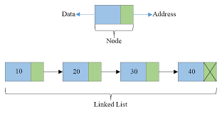
Linked List
Linked list consists of nodes where each node contains a data field and a reference pointer (link) to the next node in the list.

Slide 10
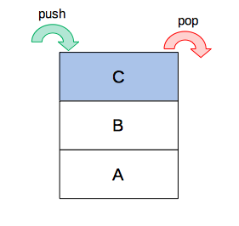
Stack
Last-In-First-Out (LIFO)
In stack, a new element is added at one end and an element is removed from that end only. The insert and delete operations are often called push and pop.
Always add a new plate on top of the stack (end of stack).
You take the top most plate(the most recently ‘pushed’ plate and that plate is ‘popped’ first).

Slide 11
Stack
Stack=[]
#append() function is used to push in a python list
stack.append(‘g’)
stack.append(‘f’)
stack.append(‘a’)
print('Initial stack') , print(stack)
Initial stack
['g', 'f', ‘a']
# pop() function to pop
# element from stack in# LIFO order
print('\nElements popped from stack:')
print(stack.pop())
print(stack.pop())
print(stack.pop())
Elements popped from stack:')
[‘a', 'f', ‘g']
print('\nStack after elements are popped:')
print(stack)
Stack after elements are popped:
[]
# uncommenting print(stack.pop())
# will cause an IndexError
# as the stack is now empty

Slide 12
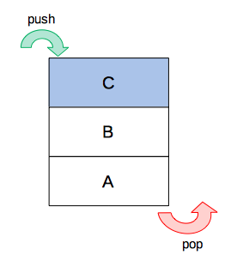
Queue
First –In- First- Out (FIFO)
The first item added to the queue will always be the first one removed
A good example of queue is any queue of consumers for a resource where the consumer that came first is served first.
Enqueue:Adds an item to the queue.
Dequeue: Removes an item from the queue.
The items are popped in the same order in which they are pushed.

Slide 13
Queue
# Initializing a queue
queue = []
# Adding elements to the queue
queue.append('a')
queue.append('b')
queue.append('c')
print("Initial queue")
print(queue)
Initial queue
[‘a', ‘b', ‘c']
# Removing elements from the queue
print("\nElements dequeued from queue")
print(queue.pop(0))
print(queue.pop(0))
print(queue.pop(0))
Elements dequeued from queue
a
b
c
print("\nQueue after removing elements")
print(queue)
Queue after removing elements
[]
# Uncommenting print(queue.pop(0))
# will raise and IndexError
# as the queue is now empty

Slide 14
Behind the scenes
Array
Collection of elements stored contiguously in memory.
Any element can be accessed with a numerical indeed (called a pointer) which points to the elements location in the array.
In python – this is implement with the list type.
Hash Tables
Unique keys are mapped to values
A dictionary is an implementation of a hash table

Slide 15

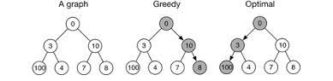
Greedy Algorithms
can only hold 20 pounds
Laptop: $2200 (3 lbs)
Monitor: $2500 (18 lbs)
Speakers: $1500 (15 lbs)
Left with only $2500, but still, you have $2500!

